Slide 1
Writing Across the Curriculum Chapter 9
Krystal Bare
Kristina Lacroix Malone

Slide 2
Organizing Principle
Writing activates learning by helping students to explore, clarify, and think deeply about the ideas and concepts they encounter in reading.

Slide 3
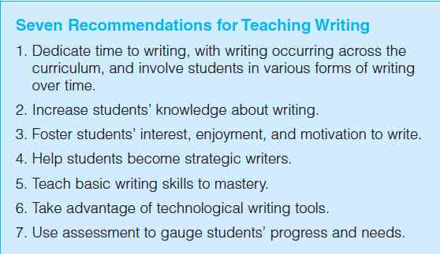

Slide 4
Ideas for Using Technology to Teach Writing
Blogs - This will teach students to write to a wider audience.
Compose writing using various tools in the classroom. Ex. Tablets
Find a real world application. Ex. online forums, research based websites, compare products.
Make writing a multimedia experience. Example: combining a video shot to a piece of poetry they have written, or write a script for a short film.
Use new technology to make it easer for student to collaborate. Example: Zoho Show and Prezi.

Slide 5
Writing across the Curriculum
Writing to Learn
Academic Journals
Integrating Reading and Writing
Writing in Disciplines

Slide 6
Writing to learn
Dialogues
Admit/Exit Slips
Biopoems
Unsent Letters
POVGs
Microthemes
Academic Journals
Response Journals
Learning Logs
Double Entry Journals

Slide 7
Integrating reading and writing
Writing in Disciplines
Exploration
Motivation
Clarification
RAFT Writing
Guiding the Writing Process

